Slide 1
SQL

Slide 2
JOIN multiple tables
All previously reviewed queries select data from a single table. In SQL, it is possible to select data from several tables with the help of one command. To do this, the tables must be joined.
By joining two tables, you will get a result in a common table. Joining takes place after so-called joining columns. You can also group more than 2 tables with a join chain.

Slide 3
JOIN multiple tables
As you can see from the previous queries, you can select, for example from the Journal table, the librarian's code, service number and how many readers each librarian served, but you would better like to see the librarian's name and service name instead of the abstract librarian's code or service number.
To solve this problem, create a query that joins several tables. For example, you need to combine tables that contain librarians' names (Librarians), service names (Services), and other necessary information (Journal).

Slide 4
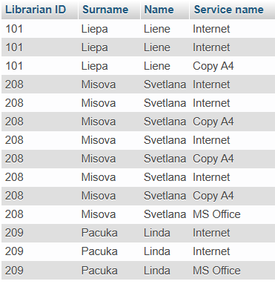
JOIN multiple tables
Example: Display the librarian’s ID, name, surname, and the name of the service provided.
SELECT j.LibID AS `Librarian ID`,
l.LSur AS `Surname`,
l.Lname AS `Name`,
s.ServiceName AS `Service name`
FROM Services s
INNER JOIN Journal j ON s.ServiceID = j.ServiceID
INNER JOIN Librarians l ON j.LibID = l.LibID
ORDER BY l.LSur ASC, l.Lname DESC;

Slide 5
Full column names and table aliases
Two joined tables can contain identically named columns. To let DBMS understand which column is in use, SQL uses full column names.
Format:
Table_name.column_name
Example:
SELECT Journal.ServiceID AS `Service ID`, Services.ServiceID

Slide 6
Full column names and table aliases
To reduce keyboard input and create more understandable queries containing joins, use the table aliases. Format:
Table alias without “AS” keyword!
Example:
FROM Services s,
which can be read as alias s was assigned to the table named Services.

Slide 7
Full column names and table aliases
Then, by selecting certain column values, you can type the following query:
SELECT s.ServiceName
FROM Services s;
This query shows that the SELECT statement uses the alias specified in the FROM statement instead of the table name.

Slide 8
JOIN multiple tables
SQL statement to join the tables:
SELECT columns
FROM table1 JOIN_type table2 ON JOIN_condition;
Where JOIN_type is one from:
Cross Join, Natural Join, Inner Join, Left Outer Join, Right Outer Join, Full Outer Join, bet
JOIN_condition statement:
table1.column1 Comparison_operator table2.column2
You can combine several conditions with AND and OR.

Slide 9
Join types
Join type | Comment
Cross Join | In a CROSS JOIN there is a join for each row of one table to every row of another table. This usually happens when the matching column or WHERE condition is not specified.
Natural Join | Natural Join joins two tables based on same attribute name and datatypes. The resulting table will contain all the attributes of both the table but keep only one copy of each common column.
Inner Join | The INNER JOIN keyword selects all rows from both the tables as long as the condition satisfies. This keyword will create the result-set by combining all rows from both the tables where the condition satisfies i.e value of the common field will be same.
Left Outer Join | This join returns all the rows of the table on the left side of the join and matching rows for the table on the right side of join. The rows for which there is no matching row on right side, the result-set will contain null. LEFT JOIN is also known as LEFT OUTER JOIN.
Right Outer Join | RIGHT JOIN is similar to LEFT JOIN. This join returns all the rows of the table on the right side of the join and matching rows for the table on the left side of join. The rows for which there is no matching row on left side, the result-set will contain null. RIGHT JOIN is also known as RIGHT OUTER JOIN.
Full Outer Join | FULL JOIN creates the result-set by combining result of both LEFT JOIN and RIGHT JOIN. The result-set will contain all the rows from both the tables. The rows for which there is no matching, the result-set will contain NULL values.
Self Join | As the name signifies, in SELF JOIN a table is joined to itself. That is, each row of the table is joined with itself and all other rows depending on some conditions. In other words we can say that it is a join between two copies of the same table.
JOINS exist only during query execution!

Slide 10
JOIN multiple tables
In addition to the mentioned join format (Join) you can join tables in WHERE format:
SELECT columns
FROM table1, table2, ...
WHERE join_condition [GROUP BY ...] [HAVING ...]
[ORDER BY ...];
join_condition statement:
table1.column1 Comparison_operator table2.column2
The standard SQL language requires the use of join union syntax, but in later versions of SQL, you can also use the WHERE format.

Slide 11
JOIN multiple tables
Query execution sequence:
The Join operator of the FROM statement is executed
WHERE statement is executed
GROUP BY statement is executed
Rows that satisfy the group condition are selected (HAVING statement)
The result is sorted (ORDER BY sentence)

Slide 12
JOIN multiple tables
Example: Display the librarian’s ID, name, surname, and the name of the service provided.
SELECT j.LibID AS `Librarian ID`,
l.LSur AS `Surname`,
l.Lname AS `Name`,
s.ServiceName AS `Service name`
FROM Services s
INNER JOIN Journal j ON s.ServiceID = j.ServiceID
INNER JOIN Librarians l ON j.LibID = l.LibID
ORDER BY l.LSur ASC, l.Lname DESC;

Slide 13
Cross Join
Cross Joins are used very rarely. This type of join does not use any condition.
Cross Join syntax:
SELECT Columns
FROM table1 Cross Join table2;

Slide 14
Cross Join
Example (Cross Join):
SELECT s.*, j.*
FROM Services s Cross Join Journal j;
Example (without Cross Join):
SELECT s.*, j.*
FROM Services s, Journal j;

Slide 15
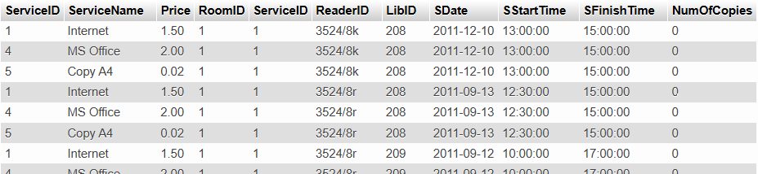

Cross Join

Slide 16
Natural Join
Natural Join Only works when the tables to be joined have at least two columns with the same names and types. In each row pair, the values ​​of the join columns are compared, and if they match in the columns, the rows will join.
Natural Join statement:
SELECT columns
FROM table1 Natural Join table2;
Where statement:
SELECT columns
FROM table1, table2;
WHERE column1=column2;

Slide 17
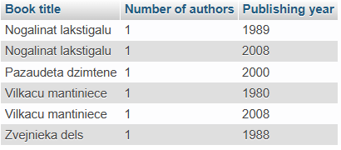
Natural Join
Example: Write a query that shows the title of the book, the year the book was published, and how many authors the book has.
SELECT book.Title AS `Book title`,
Count(tlp.AuthorID) AS `Number of authors`,
Tlp.YearOfPub AS "Publishing year"
FROM Books book Natural Join Title_page tlp
GROUP BY book.Title, tlp.YearOfPub;

Slide 18
Natural Join
Example: Write a query that shows the title of the book, the year the book was published, and how many authors the book has.
using WHERE:
SELECT book.Title AS `Book title`,
Count(tlp.AuthorID) AS `Number of authors`,
Tlp.YearOfPub AS [Publishing year]
FROM Books book, Title_page tlp
WHERE book.BookID = tlp.BookID
GROUP BY book.Title, tlp.YearOfPub;

Slide 19
Inner Join
Inner Join Uses the comparison operator to check whether the values of the 2 rows in the table join column match.
Inner Join statement:
SELECT columns
FROM table1 Inner Join table2 ON condition;
Where statement:
SELECT columns
FROM table1, table2;
WHERE condition;

Slide 20
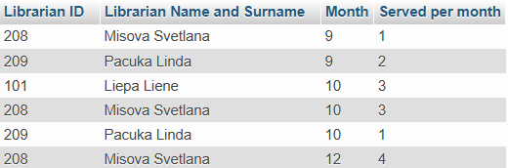
Inner Join
Example: Write a query that outputs the librarian's code, his name and last name, month, and how many readers were served by the librarian each month. Sort the result by month number and last name in alphabetical order.
SELECT l.LibID AS `Librarian ID`,
CONCAT(l.LSur, ' ', l.Lname) AS `Librarian Name and Surname`,
MONTH(j.SDate) AS `Month`,
COUNT(j.LibID) AS `Served per month`
FROM Librarians l
INNER JOIN Journal j ON l.LibID = j.LibID
GROUP BY l.LSur, l.Lname, l.LibID, MONTH(j.SDate), j.LibID
ORDER BY MONTH(j.SDate), l.LSur;

Slide 21
Inner Join
Example: Write a query that outputs the librarian's code, his name and last name, month, and how many readers were served by the librarian each month. Sort the result by month number and last name in alphabetical order.
using WHERE:
SELECT l.LibID AS `Librarian ID`,
CONCAT(l.LSur, ' ', l.Lname) AS `Librarian Name and Surname`,
MONTH(j.SDate) AS `Month`,
COUNT(j.LibID) AS `Served per month`
FROM Librarians l, Journal j
WHERE l.LibID = j.LibID
GROUP BY l.LSur, l.Lname, l.LibID, MONTH(j.SDate), j.LibID
ORDER BY MONTH(j.SDate), l.LSur;

Slide 22
Outer Joins
Inner Join combines rows in which column values satisfy the condition. External joins output all rows from one table. External joins are useful when you need to output data that may not contain matching values in the other table. For example, show courses in which no students enrolled. Outer Joins help you create reports that display all records in the same table. For example, display orders for all items, including those items that no one ordered.

Slide 23
Outer Joins
The order of the external merge tables is important, so the tables are called "left" and "right".
All external mergers are divided into:
Left – Left Outer Join - includes all rows of the "left" table
Right – Right Outer Join - includes all rows of the "right" table
Full - Full Outer Join - which is a combination of Left Outer Join and Right Outer Join

Slide 24
Left Outer Join
Statement:
SELECT columns
FROM “left“ table LEFT [OUTER] JOIN “right“ table ON condition;
condition statement:
table1.column1 comparison_operator table2.column2
You can combine several conditions with AND and OR.

Slide 25
Right Outer Join
Statement:
SELECT columns
FROM “left“ table RIGHT [OUTER] JOIN “right“ table ON condition;
condition statement:
table1.column1 comparison_operator table2.column2
You can combine several conditions with AND and OR.

Slide 26
Full Outer Join
Statement:
SELECT columns
FROM “left“ table FULL [OUTER] JOIN “right“ table ON condition;
condition statement:
table1.column1 comparison_operator table2.column2
You can combine several conditions with AND and OR.

Slide 27
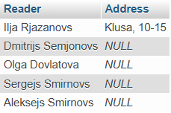
Outer Joins
Example: You need to display the addresses of readers who did not use library services.
SELECT CONCAT(rdr.ReaderName, ' ', rdr.ReaderSur) AS `Reader`,
CONCAT(rdr.Street, ', ', rdr.House, '-', rdr.Flat) AS `Address`
FROM Readers rdr
LEFT JOIN Journal j ON rdr.ReaderID = j.ReaderID
WHERE j.ReaderID IS NULL;

Slide 28
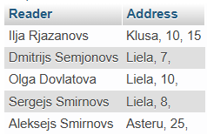
Outer Joins
Example: You need to display the addresses of readers who did not use library services.
SELECT CONCAT_WS(' ', rdr.ReaderName, rdr.ReaderSur) AS `Reader`,
CONCAT_WS(', ', rdr.Street, rdr.House, CONCAT_WS('-', rdr.Flat)) AS `Address`
FROM Readers rdr
LEFT JOIN Journal j ON rdr.ReaderID = j.ReaderID
WHERE j.ReaderID IS NULL;

Slide 29
Outer Joins
Execution sequence:
The Readers and Journal tables joined, and the rows that contain data about readers from Readers table was joined with the data about readers from Journal table that contain empty values (not used the library's services).
The system then selects only rows that are joined with "empty" rows.

Slide 30
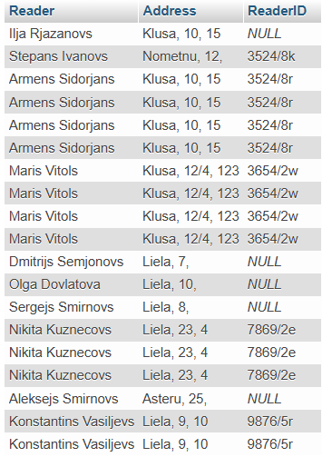
Outer Joins
Execution order:
1.
SELECT CONCAT_WS(' ', rdr.ReaderName, rdr.ReaderSur) AS `Reader`,
CONCAT_WS(', ', rdr.Street, rdr.House, CONCAT_WS('-', rdr.Flat)) AS `Address`,
j.ReaderID
FROM Readers rdr
LEFT JOIN Journal j ON rdr.ReaderID = j.ReaderID;

Slide 31
Practice
Display the title of the book and the name and surname of the author (as one field), delete duplicates, sort by book titles.
Create the rating of the most popular authors - sort by the most frequently read books (number of books taken) in descending order.
Find out if there are librarians who have not provided any services. If there are, display first name and last name.

Slide 32
Practice
Output the reader's last name, reader’s ID number, the library services he received each month and the amount he paid for each service together (display sum for the services for each month). Sort the result by alphabetical order using readers' surnames and month numbers in reverse chronological order.
Print a list of library services, how many times each service was used. Display data for each year separately. Sort in chronological order by year, and in alphabetical order by name.

Slide 33
Answers
1.
SELECT DISTINCT b.Title AS Title,
CONCAT_WS(' ', a.AuthorName, a.AuthorSur) AS Author
FROM Books b
INNER JOIN Title_page t ON b.BookID = t.BookID
INNER JOIN Authors a ON a.AuthorID = t.AuthorID
ORDER BY b.Title;
2.
SELECT CONCAT_WS(' ', a.AuthorName, a.AuthorSur) AS Author,
COUNT(a.AuthorID) AS `Number of books`
FROM Books_taken bt
INNER JOIN Title_page t ON bt.BookID = t.BookID
INNER JOIN Authors a ON a.AuthorID = t.AuthorID
GROUP BY a.AuthorName, a.AuthorSur
ORDER BY COUNT(a.AuthorID) DESC;
3.
SELECT CONCAT_WS(' ', l.Lname, l.LSur) AS Librarian
FROM Librarians l
LEFT JOIN Journal j ON l.LibID = j.LibID
WHERE j.LibID IS NULL;

Slide 34
Answers
4.
SELECT
CONCAT_WS(' ', r.ReaderSur, r.ReaderName) AS Reader,
r.ReaderID AS `Reader ID`,
MONTH(SDate) AS `Month`,
s.ServiceName AS `Service name`,
SUM(s.Price) AS `Paid`
FROM Readers r
INNER JOIN Journal j ON r.ReaderID = j.ReaderID
INNER JOIN Services s ON s.ServiceID = j.ServiceID
GROUP BY r.ReaderSur, r.ReaderName, r.ReaderID, s.ServiceName, j.ServiceID, MONTH(SDate), j.ReaderID
ORDER BY r.ReaderSur ASC, MONTH(SDate) DESC;
5.
SELECT
s.ServiceName AS `Services`,
COUNT(j.ServiceID) AS `Number`,
YEAR(SDate) AS `YearOfPub`
FROM Services s
LEFT JOIN Journal j ON j.ServiceID = s.ServiceID
GROUP BY YEAR(SDate), s.ServiceName
ORDER BY YEAR(SDate), s.ServiceName;

Slide 35
Self Join
In this case, SQL combines tables rows among themselves by comparing the values in some columns of those tables. For example, there is a table employee in which the employee (column 1) corresponds to the boss (column 3), which is also the employee himself.
EmployeeID | Surname | BossID
E1 | Saule
E2 | Zālītis | E1
E3 | Vīksna | E1
E4 | Bērzs | E3
E5 | Liepa | E3

Slide 36
Self Join
Example: Output the list in the form of an
employee - boss.
SELECT tab1.Surname AS Employee, tab1.Surname AS Boss
FROM Employees tab1 INNER JOIN Employees tab2
ON tab1.BossID = tab2.EmployeeID;
Employee | Boss
Zālītis | Saule
Vīksna | Saule
Bērzs | Vīksna
Liepa | Vīksna

Slide 37
Practice
Display surnames and names to those readers who live in the same city as the reader with the surname "Smirnovs".

Slide 38
Answers
SELECT CONCAT(r2.ReaderName, ' ', r2.ReaderSur) AS `Name Surname`
FROM Readers r1
INNER JOIN Readers r2
ON (r1.ReaderSur <> r2.ReaderSur AND r1.Town = r2.Town)
WHERE r1.ReaderSur LIKE 'Smirnovs';

Slide 39
Union operator
The Union operator combines the results of two queries. The operator ignores duplicates. You must also use the Union All operator to display duplicates. Select statements must have the same number of columns to use Union. ORDER BY statement is used only in the last query. GROUP BY and HAVING statements are used only in individual queries.

Slide 40
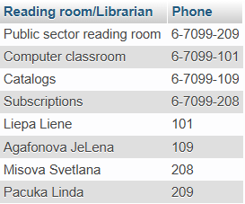
Union operator
Example: Write a query that displays the reading room name and phone number and combines this result with a query that displays librarians' names, surnames, and ID’s.
SELECT rr.RoomName AS `Reading room/Librarian`, rr.PhoneNum AS Phone
FROM Reading_rooms rr
UNION ALL
SELECT CONCAT(l.LSur, ' ', l.Lname), l.LibID
FROM Librarians l;

Slide 41
Intersect operator
The Intersect operator converts the results of two queries into one result, which includes all common rows from the results of both queries. The operator ignores duplicates. Statement: Query1 Intersect Query2;

Slide 42

Intersect operator
Example: Display the readers used the library services and took the books home. (Oracle)
SELECT Books_taken.ReaderID AS "Reader ID"
FROM Books_taken
INTERSECT
SELECT ReaderID
FROM Journal;
(with JOIN, because MySQL does not support syntactically)
SELECT DISTINCT bt.ReaderID AS `Reader ID`
FROM Books_taken bt INNER JOIN Journal j on bt.ReaderID = j.ReaderID;

Slide 43
Minus operator
The Minus operator converts the results of two queries to a table that includes only the result rows of the first query that are not the result of the second query.
Statement: Query1 Minus Query2;

Slide 44

Minus operators
Example: Display readers that did not use library services, but took books home. (Oracle)
SELECT Books_taken.ReaderID AS "Reader ID"
FROM Books_taken
MINUS
SELECT ReaderID
FROM Journal;
(with JOIN, because MySQL does not support syntactically)
SELECT DISTINCT bt.ReaderID AS `Reader ID`
FROM Books_taken bt LEFT JOIN Journal j on bt.ReaderID = j.ReaderID
WHERE j.ReaderID is NULL;

Slide 45
Practice
Output the names of all people in DB (authors, readers, librarians). Output titles of never-taken books Display librarians who provided absolutely all services

Slide 46
Answers
1.
SELECT r.ReaderName AS Name, r.ReaderSur AS Surname
FROM Readers r
UNION ALL
SELECT l.LName, l.LSur
FROM Librarians l
UNION ALL
SELECT a.AuthorName, a.AuthorSur
FROM Authors a;
2.
(Oracle)
SELECT BookID
FROM Books
MINUS
SELECT BookID
FROM Books_taken;
3.
(Oracle)
SELECT LibID AS "Librarians"
FROM Journal
WHERE ServiceID = 1
INTERSECT
SELECT LibID
FROM Journal
WHERE ServiceID = 4
INTERSECT
SELECT LibID
FROM Journal
WHERE ServiceID = 5;

Slide 47
Answers
2.
(MySQL)
SELECT b.Title
FROM Books b LEFT JOIN Books_taken bt on b.BookID = bt.BookID
WHERE (bt.BookID is NULL);
3.
(MySQL)
SELECT j.LibID AS Librarian
FROM Journal j
GROUP BY j.LibID, j.ServiceID
HAVING Count(j.LibID)=3;

